Slide 1
MAR 530: Ecosystem Based Fisheries Management
Lecture 1
Introduction
www.mycourses.umassd.edu
30 January 2015

Slide 2
Today’s Outline
Introductions
Course Mechanics, etc.
What is EBFM?
Discussion on:
Larkin 1996
Botsford et al. 1997
Pikitch et al. 2004

Slide 3
Instructor contact information
Gavin Fay
gfay@umassd.edu
508-910-6363
SMAST II Rm 325B
@gavin_fay
Office hours: by appointment

Slide 4
Course participants
Who, why, when, what, where:
Degree status
Program
Research interests
Background and experience
Why are you taking this class?

Slide 5
Course materials
MAR530 course website on myCourses
Syllabus
Lecture materials
Readings
Assignment submission
Discussion board
Is anyone NOT receiving info from myCourses?

Slide 6
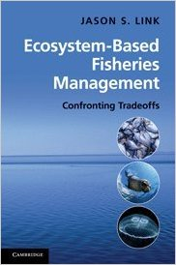
Course Text

Slide 7



Other books for background reading

Slide 8
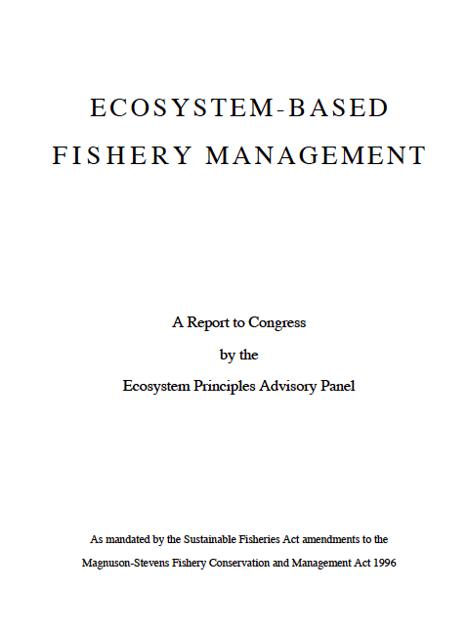
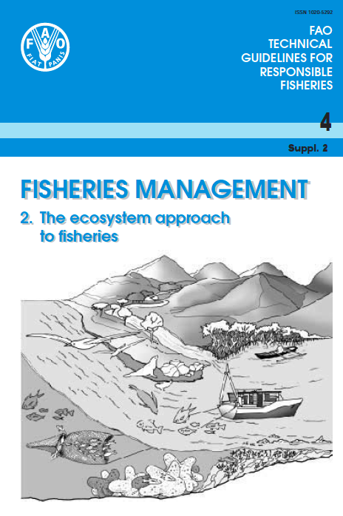

At least read the executive summaries….
NMFS 1999
FAO 2003
NMFS 2009

Slide 9
Course mechanics: Format
Each week:
1. Informal lecture
2. Break
3. Discussion/Recitation
Student led on the literature for each week

Slide 10
Course mechanics: Evaluation
Weekly Assignments (25%)
Class Project (25%)
Final Exam (10%)
Participation (40%)
University Academic Integrity policy applies: http://www.umassd.edu/studentaffairs/studenthandbook/academicregulationsandprocedures/

Slide 11
Weekly assignments (25%)
Eight brief (one page max) writing assignments
Summary/synthesis of piece of current peer-reviewed literature relevant to the week’s discussion topic.
One blog post
Follows on the previous week’s class discussion.
Sign-up sheet on course website.
No 1-pager required the week of your blog post.
Assignments are due prior to class.
10/100 deducted for each day late.

Slide 12
Class project (25%) & Final Exam (10%)
Written report (20%) on either:
Case study where EBFM is being implemented,
Analysis/review of an emerging EBFM topic.
Descriptions of project topics due February 20.
2-3 page project outline (5%) due March 13.
Projects can be individual or small groups.
Final Exam – Verbal presentation of project.

Slide 13
Participation, attendance, ethics (40%)
Find and distribute an article each week
(can be article used in weekly assignment)
Participate in Discussions of Readings
Sign-up for papers online
Lead at least one weekly class discussion
Post responses to blog posts in at least two weeks

Slide 14
Literature
List of background readings on syllabus and myCourses.
Pdf’s of weekly readings on myCourses.
Sign up for which ones to lead in discussion, report upon.
Find new pieces of EBFM literature, distribute each week.

Slide 15
Tips for Critically Reading Literature
What are the main points of the paper?
What type of document is it?
Who wrote it, who do they work for, what is their reputation, who funded it, etc.?
Why was the work written? Is the objective clearly stated?
Does the evidence support the conclusions?
Is the logic reasonable and easy to follow?

Slide 16
Tips for Critically Reading Literature
Are there any novel methods worth considering?
Are there any novel concepts worth considering?
Is there anything in it that you can use for your own work (rates, concepts, estimates, etc.)?
As you read it, how would you describe this work to:
Your parents
A high school class
A congressional delegation
Your scientific peers

Slide 17
Course objectives
Understanding of major issues facing global fisheries, fisheries science, and fisheries management.
Familiarity with the theory, history, background, and socio-economic issues driving EBFM.
Develop knowledge of major modeling and technical approaches for implementing EBFM.
Develop skills for critically evaluating current literature and contextualizing it and associated theory with real world case studies.

Slide 18
One main theme throughout course….
CONFRONTING TRADEOFFS

Slide 19
Simplified Schedule
Week | Theme | Topic
1/30 | Context | Introduction, What is EBFM?
2/6 |  | Challenges facing fisheries, what can EBFM offer?
2/13 |  | Guest lecture: case studies of EBFM
2/20 |  | When to consider doing EBFM?
2/27 |  | Types of advice, decision theories, goal-setting
3/6 | Operational | Ecosystem indicators
3/13 |  | Extended single-species and multispecies models
3/20 |  | SPRING BREAK
3/27 |  | Aggregate and system models
4/3 |  | Ecological risk assessment
4/10 | Institutional | Societal and economic considerations
4/17 |  | Governance and management institutions
4/24 | Holistic | Evaluating tradeoffs
5/1 |  | Moving towards ecosystem based management
5/13 |  | Final exam: Project Presentations

Slide 20
What is a fishery?
The complex of people, their institutions, their harvest and their observations associated with and including a targeted stock or group of stocks (i.e., usually fish)

Slide 21
Fishery
Management
Economic
Considerations
Social
Considerations
Conservation
Requirements

Slide 22
Limnology &
Oceanography
Population
Biology
Resource
Economics
Fishery
Science
Social
Sciences
Stock
Assessment
Ecosystem
Dynamics

Slide 23
Why is “ecosystem management” an issue?
Competing stake-holders and legislation
Debate over the importance of different processes (fishing, environment, predation, etc.)
Limitations of single species management
Used as a scapegoat for lack of action
Adversarial science- scientists as advocates

Slide 24
What is Ecosystem Based Fisheries Management?

Slide 25
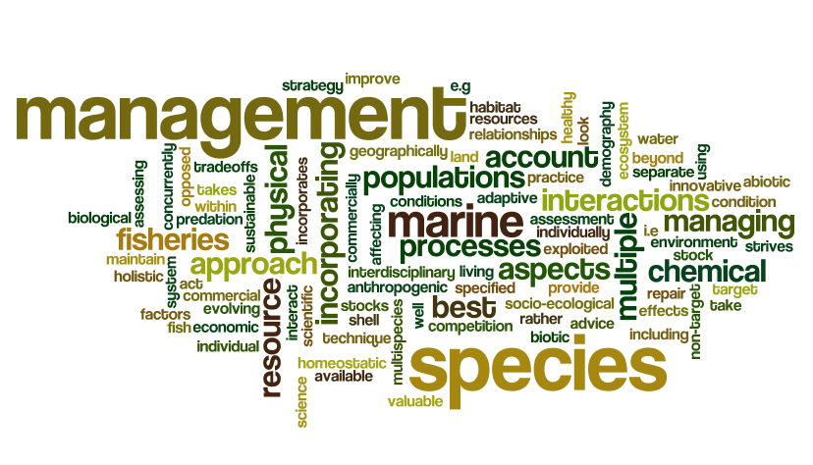
What is Ecosystem Based Fisheries Management?

Slide 26
What is EBFM?
“Managing fisheries to coordinate, account for, and include all factors in a holistic, synthetic, integrated fashion. Fisheries are emphasized, but the inclusion of marine mammals, protected species, non-target species, etc., are explicitly included.”
“Ultimately what EAF/EBFM means is that we are trying to manage fisheries in a broader ecosystem context, ….”
(Link 2010)

Slide 27
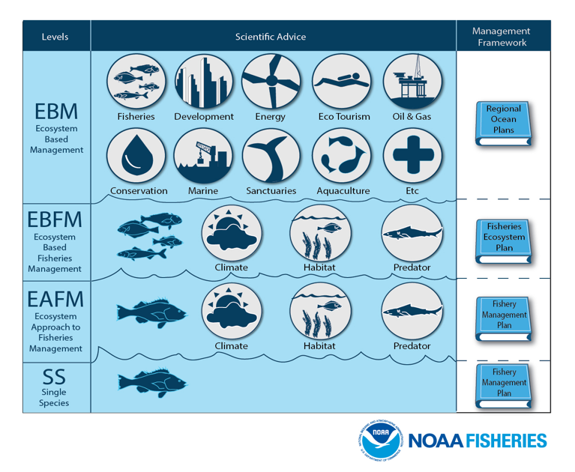

Slide 28
What does an Ecosystem Approach provide that we can’t get from single-species?
Address effects of fishing on:
non-target species
habitat,
ecological interactions, and
system-wide processes
Recognizes that marine ecosystems provide “goods & services” other than fishery harvest
Explicitly addresses biomass tradeoffs
Increases leverage from new stakeholders
Changes the burden of proof

Slide 29
What is the issue?
Is Fishing impacting other Ecosystem Components & Properties?
Impacts to other Fishing Sectors
Impacts Across broader Ocean-use sectors
Impacts to other, legally considered spp.
Are other Ecosystem Considerations impacting the fishery (i.e. fish stocks)?

Slide 30
What is EBFM?
Questions?

Slide 31
What’s next
Fisheries Science Review
Challenges Facing Fisheries
What does EBFM have to offer?
Discussion on:
Caddy 1999
Guerry 2005
Browman & Stergiou 2004

